Slide 1
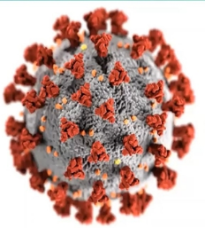

CDPH Dental Guidance Overview
LOHP Dental Guidance Webinar
May 14, 2020
11:00am – 12:00pm
Notes:
Welcome

Slide 2
Office of Oral Health Contributors
Dr. Jay Kumar, DDS, MPH, California State Dental Director
Dr. Lynn Walton-Haynes, DDS, MPH, Dental Program Consultant
Rosanna Jackson, Chief, Statewide Community and Intervention Section
Joanna Aalboe, RDH, MPH, Health Program Manager
Jessica Byers, MPH, MS, Health Program Specialist
Nicole Garvin, Office Assistant
Miranda Walker, MA, Health Program Specialist
Notes:
The purpose of this webinar is to inform you how the pandemic known as COVID-19 or commonly known as the Coronavirus is affecting the ability to conduct oral health activities in the state of California both in the public and private sectors.

Slide 3
Topics
Background on COVID-19 Pandemic in California
Infection control practice
Updated guidance for resuming deferred and preventive care
Role of LOHP
Resources

Slide 4
Housekeeping
  During Meeting: Everyone except the presenters will be on mute. Please use the Chat Box (bottom right). Questions will be answered at the end of the meeting as time permits.
  Audio: If you are having difficulties hearing the audio portion of the webinar through your computer, select the “Audio” box feature (right hand side of your screen) for a dial by phone option.
  After Meeting: Submit questions to DentalDirector@cdph.ca.gov
  Summary of Q&A
  Recording: This webinar will be recorded.

Slide 5
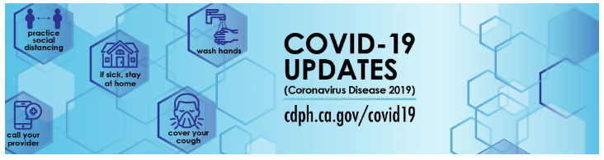
Stay Informed
https://www.cdph.ca.gov/Programs/CID/DCDC/Pages/Immunization/ncov2019.aspx
Notes:
The most important thing to do in this new and challenges time is to stay updated and informed. There are a variety of reliable sources to help you stay in the know. The slide on the screen shows where you can access CDPH COVID-19 updates. This site also provides links to other reliable sources including the Center for Disease Control (CDC), American Dental Association…
Do: Click on the link to show most current information and briefly review the most current updates listed on the webpage. Not sure if you will want to do this - Jess

Slide 6
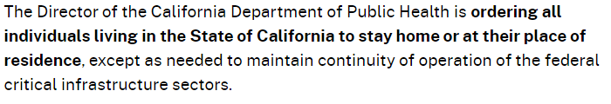
Stay Home Executive Order N-33-20
On March 19, 2020, Governor Newsom issued Executive Order N-33-20 directing all residents immediately to heed current State public health directives to stay home, except as needed to maintain continuity of operations of essential critical infrastructure sectors and additional sectors as the State Public Health Officer may designate as critical to protect health and well-being of all Californians.
https://covid19.ca.gov/stay-home-except-for-essential-needs/
https://covid19.ca.gov/img/EssentialCriticalInfrastructureWorkers.pdf
Notes:
In summary, Governor Newsom signed the Home Executive Order N-33-20 on March 19th, directing all California residents to follow directives to stay home, except as needed to maintain continuity of operations of essential critical infrastructure sectors designate as critical to protect health and well0being of all Californians. Dentists a part of the essential critical infrastructure sector.

Slide 7
Infection Control Practice
During COVID Pandemic
Federal
State
Local
CDC, OSHA, FDA
State Boards, Cal/OSHA,
State Health Officer
CDPH
Local Health Officer

Slide 8
CDC Interim Guidance for Dental Settings During COVID-19 Response
Key Concepts 4/7/20 Key concepts and updated 4/27/20
Dental settings have unique characteristics that warrant additional infection control considerations.
Postpone elective procedures, surgeries, and non-urgent dental visits.
Proactively communicate to both staff and patients the need for them to stay at home if sick.
Know steps to take if a patient with COVID-19 symptoms enters your facility.
More Info:
https://www.cdc.gov/coronavirus/2019-ncov/hcp/dental-settings.html.
Notes:
Our initial first guidance came out earlier in the pandemic on April 27th and provided guidance to the dental community regarding emergency dental care. At the time only emergency care was recommended by CDC to both 1) conserve PPE and 2) minimize the spread of infection while the number of cases was increasing rapidly threatening to overwhelm the health care system’s ability to respond to the crisis.

Slide 9
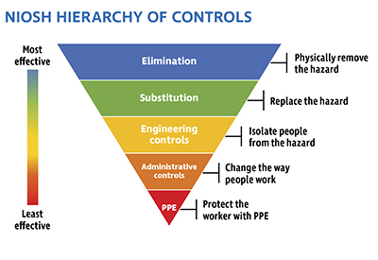
Work Practice and Patient Management
Screen and rule out COVID-19
No drugs yet
Create barriers, use evacuation system, dental dam, other tools
Personal hygiene, limiting the number, and keeping a 6-foot separation, masks
Respirators, masks, face shield, eye protection, gloves and protective clothing
More Info: https://www.cdc.gov/coronavirus/2019-ncov/hcp/respirators-strategy/index.html
Notes:
Have patient scheduling and flow protocols and infection control precautions in place to minimize exposure to and spread of COVID-19. Limit the number of patients in the office or clinic at any one time to maintain physical distancing of a minimum of six feet between patients. If physical distancing is not possible inside the waiting room, consider having patients wait outside and ensure that all patients are wearing a protective face covering.

Slide 10
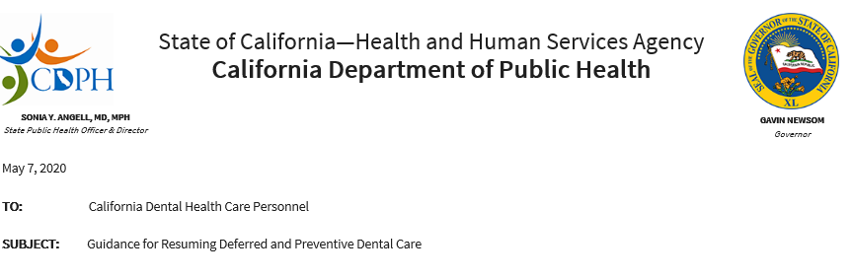
Resuming Deferred and Preventive Dental Care
More Info:
https://www.cdph.ca.gov/Programs/CID/DCDC/Pages/Guidance-for-Resuming-Deferred-and-Preventive-Dental-Care--.aspx
Notes:
As California moves into the next phase of starting to re-open, some services will soon resume.
On April 27th, CDPH State Health Officer, Dr. Sonia Angell released: Resuming California’s Deferred and Preventive Health Care guidance. It includes info on the background, how it applies to dental setting, personal protective equipment and screening for both dental patients as well as staff.
Guidance begins:
​During the COVID-19 pandemic both State and Local governments have worked together to respond to the pandemic. Stay-at-Home orders are in place and have supported the flattening of the curve in California. During this time, non-urgent health care has been deferred to support the State's efforts and to further prevent the spread of COVID-19. This deferral of services was essential in response to the surge of COVID-19 patients, but creates its own public health impacts, which must be addressed as soon as practicable
Even though current evidence shows progress in suppressing the virus, there is much to consider for the future of the State and to protect against a surge, once Stay-at-Home orders are modified. One important focus will be resuming our existing health care system for non-emergent and non-COVID-19 health care, which has been deferred during this time. These services will include resuming elective and non-urgent procedures at hospitals; outpatient care including primary care and specialty care in physician offices and health centers; behavioral health, long term care, ancillary, pharmacy, and dental services. This is to restart the care that has been postponed including preventive care such as well-child visits and vaccinations, adult clinical preventive services, and routine dental services. Whenever appropriate for patient and condition, visits should maximize the use of telehealth/telephonic modality.
This guidance is intended to set a plan for California while understanding there may be local or regional circumstances that require different timelines for resumption of services.

Slide 11

Clinically Necessary Dental Care Guidelines
Previously deferred treatment
Previously scheduled urgent procedures
Patients who are likely to develop dental emergencies
Preventive services (fluoride, sealants, scaling)
Non-aerosol generating dental procedures (SDF, ART, IRT, etc..)
If aerosol generating procedures are necessary, employ aerosol management tools
Notes:
On May 7th CDPH released CDPH Guidance for Resuming Deferred and Preventive Dental Care. The next several slides will follow details about the guidance slides will cover the new guidance…….This guidance is to assist dentists who are resuming dental care that had been deferred for the past few months, this care includes…
Read slide

Slide 12
Local Health Officer Order and Alignment with CDPH Guidance
Local health officer action | Then
Issued local guidance | Align with State Guidance
Would like more stringent guidance due to community conditions | Issue “local” guidance
Has not issued guidance | Reinforce CDPH Guidance
Notes:
Pick between this slide and the slide before (delete one you don’t want)

Slide 13
Updated Guidance - General Considerations
Local Geographic Orders
Supplies
Screening & Testing
Visual Signs

Slide 14

Dental Specific Considerations
Evaluate the necessity of care
Have patient scheduling and flow protocols
Comply with Cal/OSHA requirements
  Not perform dental procedures on COVID-19 patients
  Update office Injury and Illness Prevention Program
  Develop a Respiratory Protection Program
  Ensure that employees are trained

Slide 15
Patient and Staff Screening
All patients and dental practice staff must be screened for contact and symptoms of COVID-19 prior to entering the dental facility
Symptoms
Difficulty breathing
Shortness of breath
Coughing
CONTACT
Fever
Sore Throat
Chills
Headache
Repeated shaking with chills
New loss of taste or smell
Muscle Pain
More Info: https://www.cdc.gov/coronavirus/2019-ncov/symptoms-testing/symptoms.html
Notes:
Screening should include an assessment of:
Exposure to someone diagnosed with COVID-19 in the past 14 days; or,
Cough, shortness of breath, unexplained fever (≥100.4º F), chills, repeated shaking with chills, muscle pain, headache, sore throat, and/or new loss of taste or smell within the prior two weeks.

Slide 16
Provision of Dental Care to Patients without COVID-19
At a minimum, dental practitioners must follow the CDC recommendations for:
Engineering controls and work practices
Infection control measure
  Source control, PPE use, Hand hygiene, Screening and monitoring of DHCP, and Patient management.
Clean and disinfect office spaces, patient rooms, and equipment

Slide 17
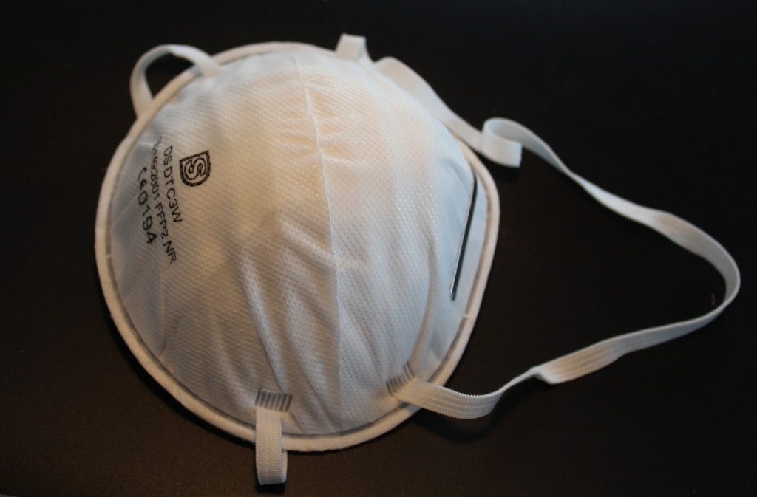
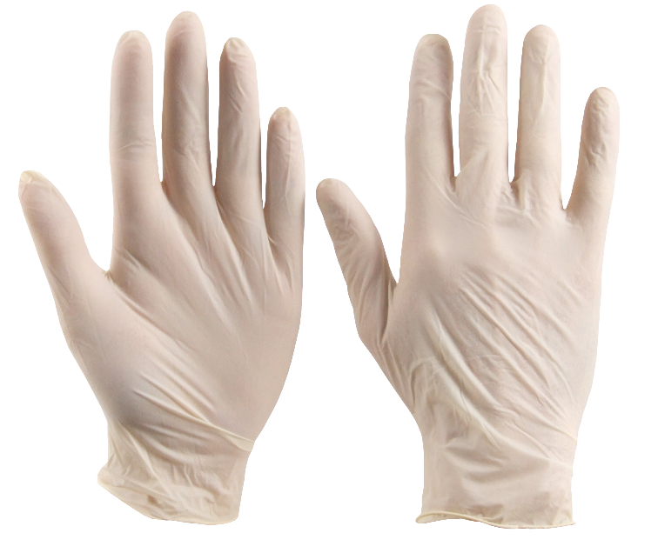
Personal Protective Equipment (PPE)
Specify equipment website for CDC PPE guidance
Have 2-weeks supplies on hand
MHOAC centers for supplies: Hospitals prioritized, can still request, MHOAC Contact List https://emsa.ca.gov/medical-health-operational-area-coordinator/
Notes:
MOACH -
Lynn Need to add talking points form…..
Supplies
Dentists must ensure they have adequate supplies including personal protective equipment (PPE) and sanitation supplies.
It is strongly recommended that dental practices have a minimum 2-week supply of PPE for dentists and staff. This includes N95 masks, face shields, goggles, surgical masks, and other infection control equipment. Dental offices should also consider making masks available to all patients prior to entering the dental office to ensure minimal exposure to air particles in the practice.
n the next several slides we will consider several aspects that affect the provision of dental services. We will then talk about what the local oral health program staff can do in this arena, as well as how it will impact delivery of LOHP services and planned activities.

Slide 18

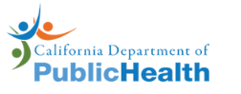



Resources and Guidelines
https://www.cdc.gov/coronavirus/2019-ncov/index.html
https://www.cdph.ca.gov/Programs/CID/DCDC/Pages/Immunization/ncov2019.aspx
https://www.cdph.ca.gov/Programs/CID/DCDC/Pages/COVID-19/GuidanceforDentistry.aspx
https://success.ada.org/en/practice-management/patients/infectious-diseases-2019-novel-coronavirus
https://www.adha.org/resources-docs/ADHA_TaskForceReport.pdf
https://www.cda.org/Home/News-and-Events/COVID-19-coronavirus-Updates
Notes:
There are a variety of resources, out there. Many of them point back at each other, but for dental related COVID-19 information the CDC, CDPH, ADA, and CDA are your primary resources, and their webpages pertaining to COVID-19 are all linked here.

Slide 19
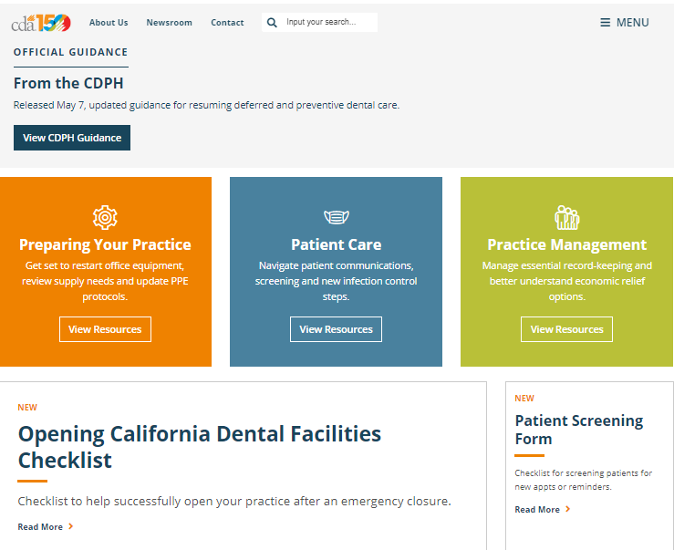
CDA Resources
Regulatory Compliance Manual
  Respiratory Protection Program
Checklists
Forms

Slide 20
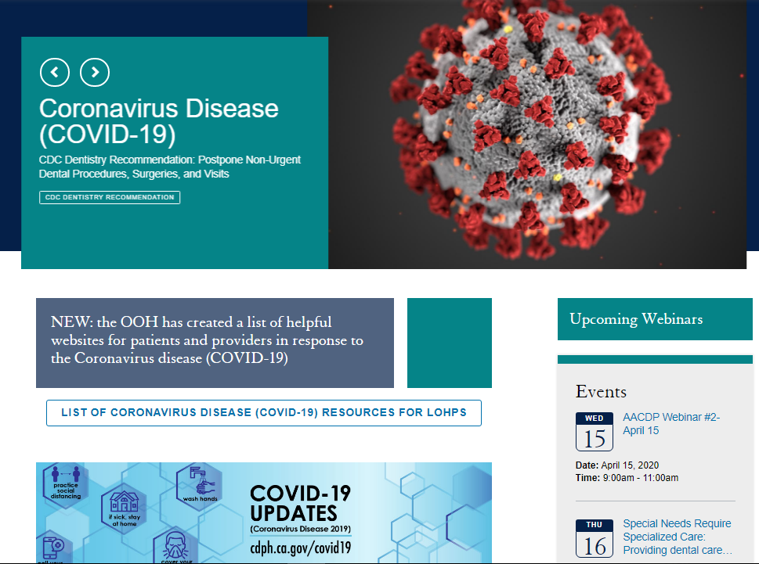
California Oral Health Technical Assistance Center COHTAC
https://oralhealthsupport.ucsf.edu/california-oral-health-technical-assistance-center
Notes:
Also check the California Oral Health Technical Assistance Center COHTAC website for COVID reacted dental and oral health updates.

Slide 21
COVID-19 & LOHPs
Think of Prop 56 activities
Training
Deployed to other public health functions
Provide resources to answer questions
Notes:
During the pandemic many LOHP staff are redirected to assist with CODIV related activities.
LOHPs can (insert guidance that Joann /Rosanna sent last week)
Also,
LOHPs should assess N95 respirator fit testing availability for DHCP by contacting hospitals and other entities. If there’s a fee for coordinating, they may use their funds.

Slide 22
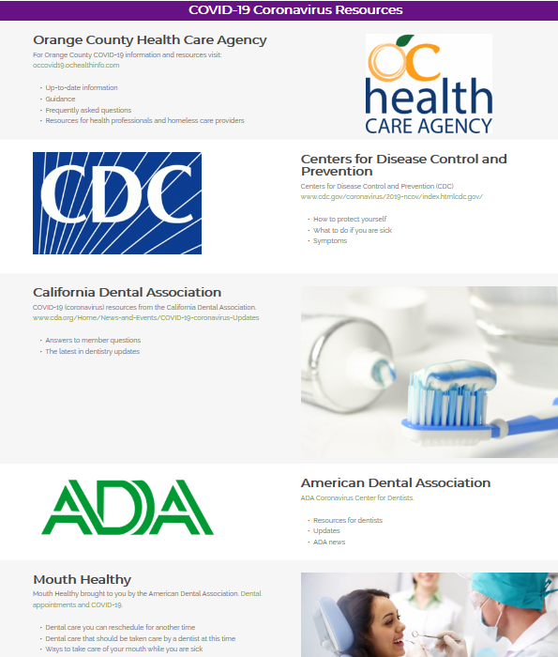

What information can LOHPs provide?
Notes:
Here is a great example of what the Orange County LOHP is doing.. They have wrote a note on the Smile Habits webpage to the community about the pandemic and provide information and links to all the top resources available where the community can learn more, like the CDC and ADA.

Slide 23
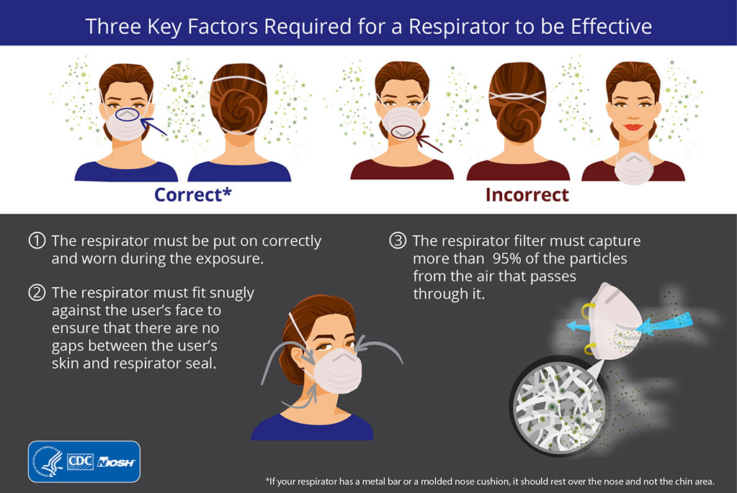
N95 Respirator Fit Testing
Amador LOHP is arranging a training session for dentists by contracting with a local training company

Slide 24

Oral Health Program
Covid-19 for families & hand washing
Pregnancy & COVID
Dental -Tooth or Mouth Pain Guidance, Fluoride Varnish Brochure
Tooth brush kit (toothpaste, floss, timer & toothbrush)
Food box availability, Rethink Your Drink, healthy snacks. (The Charter school received Potter the Otter book as well as the other items noted)
TUPP - Quit Smoking & Vaping info/Helpline services

Slide 25
COVID 19 Dental Guidance Key Messages
Stay updated on your County specific developments
Assure COVID screening of all staff and patients
Employ workplace practices to minimize risks
Prioritize non- aerosol generating procedures
If aerosol generating procedures are undertaken, take extra precautions
Follow CDC guidance
Organize training for N95 Fit Testing

Slide 26

Questions?
Notes:
Maybe ADD nice QA graphic

